Slide 1
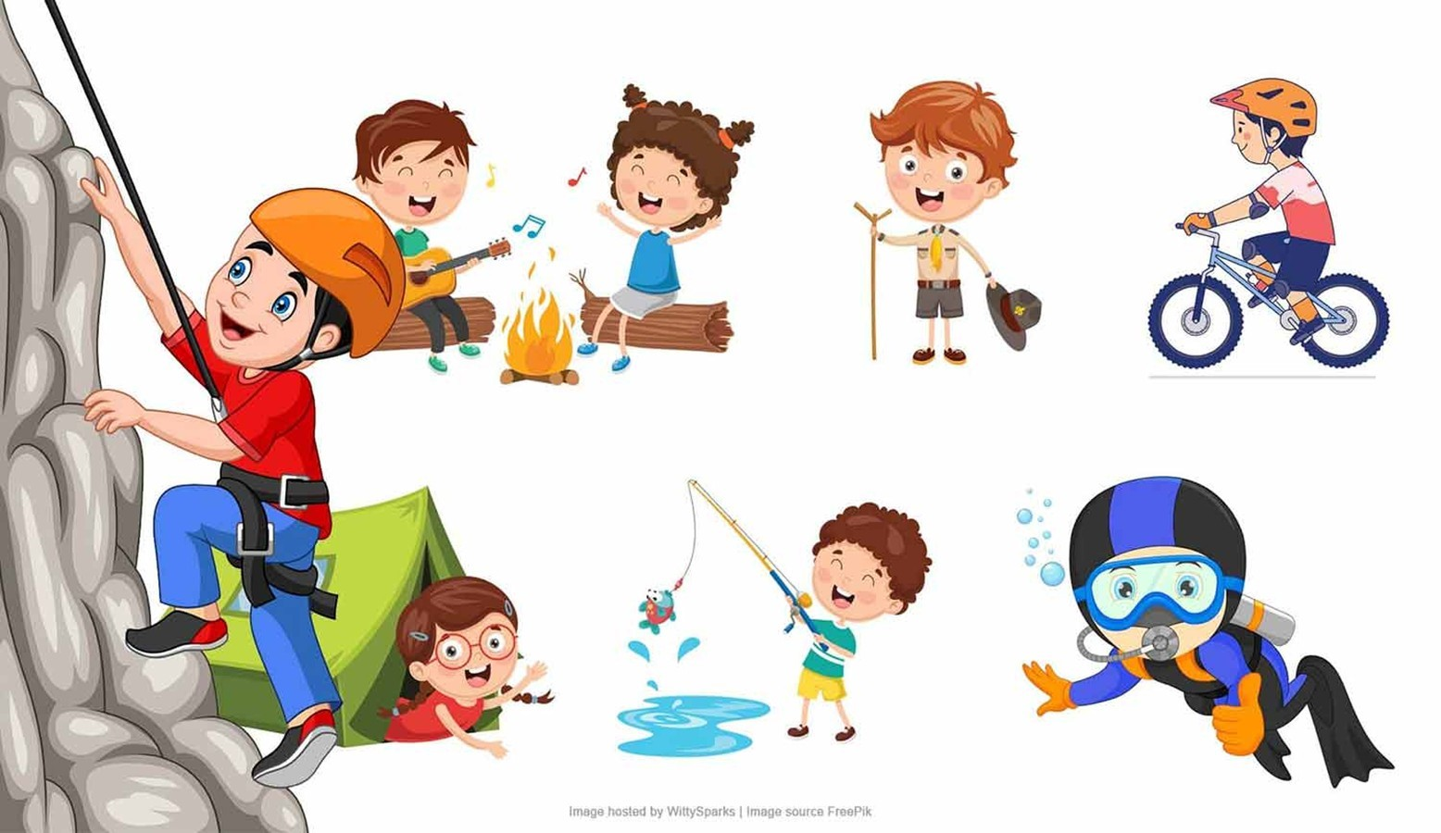
E - Content for Skill Enhancement Course For
Semester - I (Under Graduate) DDU Gorakhpur University
SE1 PED
FITNESS AND RECREATION
UNIT – II
RECREATIONAL ACTIVITIES
Developed and Compiled by:
Prof. Vijay Chahal, Department of Physical Education, DDU Gorakhpur University, Gorakhpur.
Mr. Akash Vishwakarma, Guest Faculty, Department of Physical Education, DDU Gorakhpur University, Gorakhpur.

Slide 2
Recreational Activities: Overview
Recreational activities are leisure pursuits that individuals engage in to relax, refresh , and enhance their well-being.
These activities include a wide range of physical, mental, and social exercises, such as sports, games, arts, music, and outdoor activities. Recreation serves as an antidote to the stresses of daily life, promoting a balanced lifestyle.
Types of Recreational Activities:
Physical Recreation: Sports, hiking, cycling, swimming.
Mental Recreation: Chess, puzzles, reading, meditation.
Social Recreation: Group games, team sports, cultural events.
Creative Recreation: Art, dance, writing, photography.

Slide 3
Need and Importance of Recreational Activities
Recreational activities play a crucial role in the holistic development of individuals and the community. Their significance can be understood across various dimensions:
1. Physical Health Benefits
Enhances cardiovascular fitness and muscular strength.
Helps maintain a healthy weight, reducing the risk of lifestyle diseases like obesity and diabetes.
Promotes better sleep patterns and energy levels.

Slide 4
2. Mental Health Benefits
Reduces stress, anxiety, and depression by releasing endorphins.
Improves cognitive function, memory, and focus.
Encourages creativity and problem-solving skills.
3. Social Benefits
Encourages social bonding and teamwork.
Provides opportunities to build friendships and strengthen community ties.
Teaches values like cooperation, respect, and empathy.

Slide 5
4. Emotional Benefits
Boosts self-confidence and self-esteem.
Offers a sense of achievement and satisfaction.
Helps individuals manage emotions and develop resilience.
5. Cultural Preservation
Indigenous and traditional recreational activities help preserve cultural heritage and promote diversity.
6. Economic Benefits
Reduces healthcare costs by promoting a healthier lifestyle.
Encourages tourism and boosts local economies through organized recreational events.

Slide 6
Difference Between Minor Games and Recreational Games
Aspect | Minor Games | Recreational Games
Definition | Simple, informal games with fewer rules, often used for skill development and fun. | Activities done during leisure time for relaxation, fun, and social bonding.
Purpose | To develop basic motor skills, coordination, and promote active play. | To provide relaxation, enjoyment, and rejuvenation.
Complexity | Simple rules and easy to understand; requires minimal setup or equipment. | Can range from simple to complex; may involve equipment or planned activities.
Examples | Tag, hopscotch, duck-duck-goose, Simon says. | Hiking, cycling, chess, group dance, swimming.
Focus | Primarily on physical activity and skill-building for children or beginners. | Focuses on mental relaxation, physical fitness, or social interaction.
Target Group | Typically designed for children but can be played by all ages. | Suitable for all age groups, often tailored to individual interests.
Competitiveness | Usually non-competitive; more about participation and fun. | Can be competitive (e.g., board games, sports) or purely recreational.
Setting | Played in schools, parks, or open spaces, often in a group. | Can be done indoors or outdoors, alone or in groups.

Slide 7
Participation in Minor Games
Minor games are simple, fun, and informal activities that are easy to learn and play. They often have fewer rules, don’t require special equipment, and can be played in small spaces. These games are typically non-competitive and focus on enjoyment rather than skill or strategy.
Examples of Minor Games:
Tag: One player chases others to tag them.
Hopscotch: Players hop on one foot through a pattern drawn on the ground.
Duck-Duck-Goose: A group sits in a circle while one person walks around tapping heads and chooses a "goose" to chase them.
Simon Says: Players follow commands only if preceded by "Simon says."

Slide 8
Importance of Participating in Minor Games:
Skill Development: Helps in developing fundamental motor skills like running, jumping, and throwing.
Teamwork and Communication: Fosters cooperation and strategic thinking.
Inclusivity: Encourages participation by reducing barriers related to skill or fitness level.
Engagement: Provides a fun and relaxed environment, increasing participation and interest in physical activity.

Slide 9
Sports Activities:
Sports activities are structured physical exercises governed by rules and often involve competition. These activities, such as football, basketball, and athletics, promote physical fitness, discipline, and teamwork.
Importance of Sports Activities:
Physical Fitness: Enhances overall fitness and builds endurance.
Skill Development: Sharpens specific skills like agility, coordination, and speed.
Mental Toughness: Encourages focus, discipline, and resilience in challenging situations.
Leadership and Teamwork: Develops leadership qualities and a sense of responsibility within a team.

Slide 10
Participation in Indigenous Sports Activities
Indigenous Sports:
Indigenous games are traditional sports and activities that have been practiced within a particular culture or community for generations.
These games reflect the cultural heritage, lifestyle, and values of the community and are often simple, requiring minimal equipment.
Indigenous games promote physical fitness, social bonding, and cultural preservation.

Slide 11
Kabaddi
A team sport where players raid the opposing team's side, tag opponents, and return without being caught or running out of breath.
Kho-Kho
A tag game played between two teams, where one team chases and tries to touch members of the opposing team within a time limit.
Mallakhamb
A traditional sport involving gymnastic and yoga poses performed on a vertical wooden pole or rope.
Gilli-Danda
A game similar to cricket, where players use a stick (danda) to strike a smaller stick (gilli) and score points by hitting it as far as possible.
Lagori (Seven Stones)
A game where one team knocks down a stack of seven stones with a ball, and the other team tries to rebuild the stack while avoiding being hit by the ball.

Slide 12
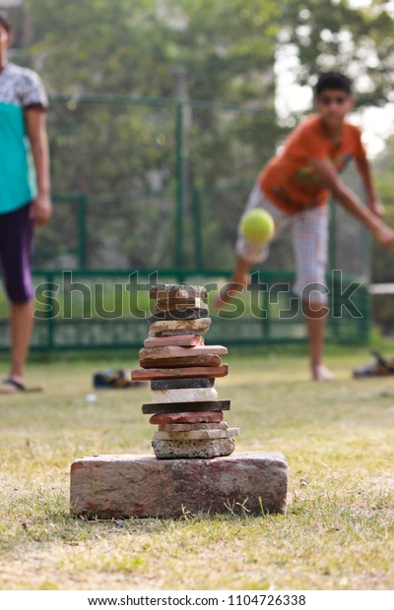
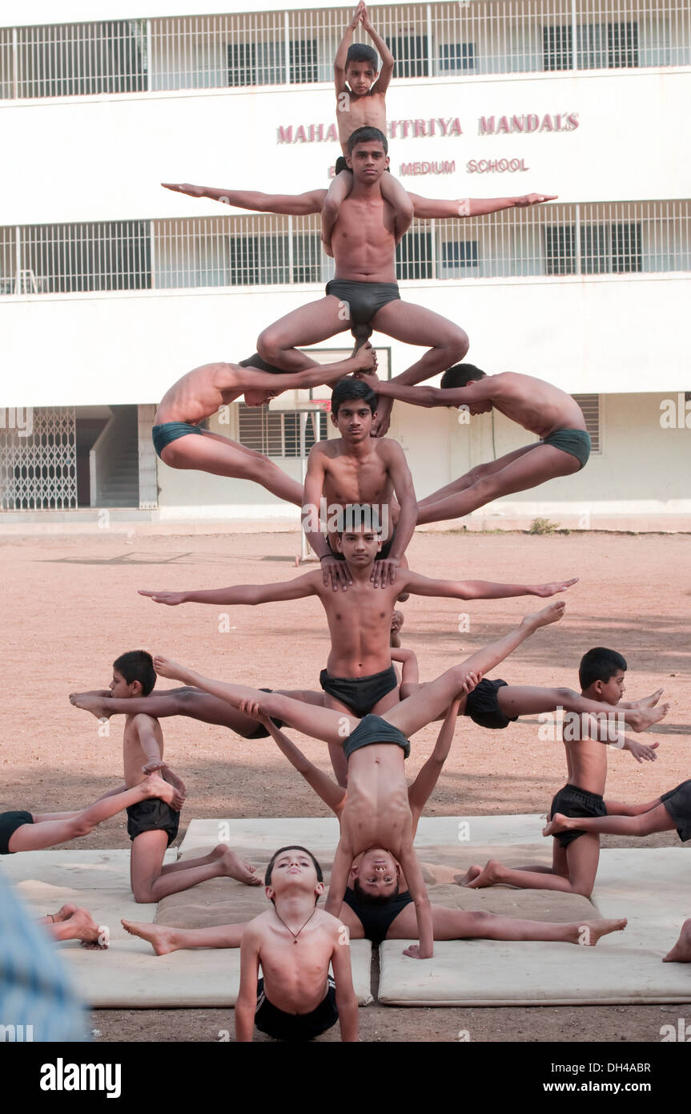
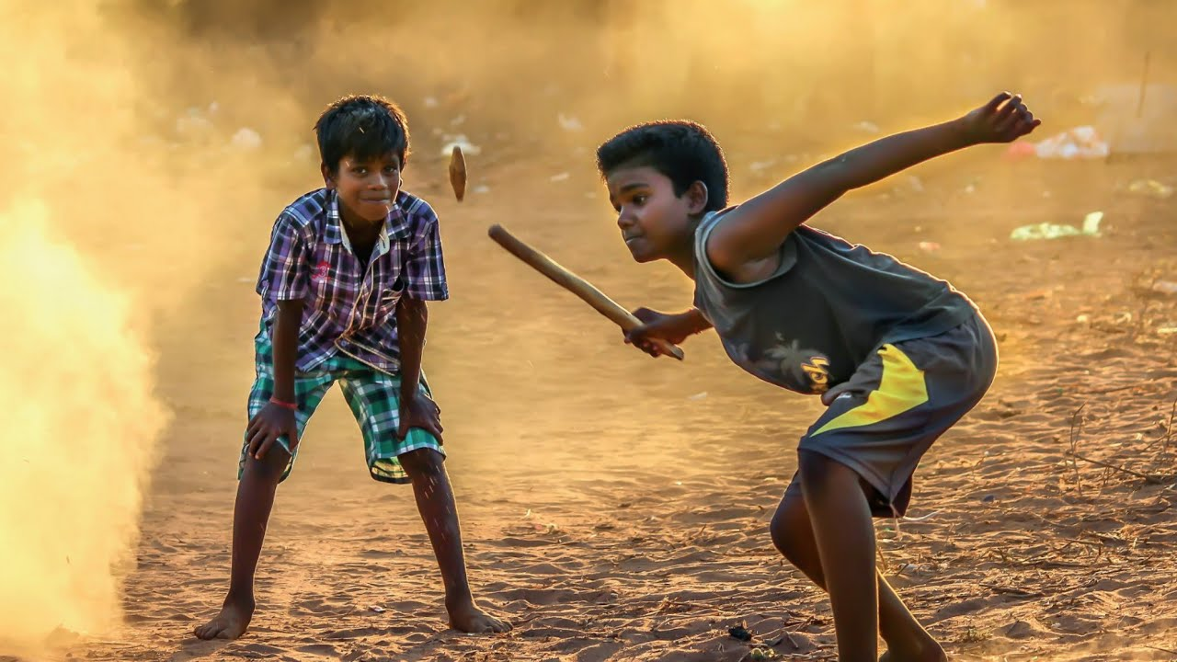

Slide 13
Importance of Indigenous Sports:
Cultural Preservation: Maintains and celebrates cultural identity and heritage.
Community Building: Brings people together, fostering unity and pride.
Physical Fitness: Enhances fitness through unique and diverse activities.
Skill Enhancement: Develops distinct skills like balance, strategy, and adaptability.
Inclusivity: Often accessible and adaptable for people of all ages and abilities.

Slide 14
Benefits of Participating in Indigenous Sports:
Cultural Awareness: Promotes understanding and appreciation of diverse traditions.
Economic Opportunities: Encourages tourism and local development through festivals and events.
Educational Value: Teaches historical and cultural narratives embedded in the sports.

Slide 15
REFERENCE
https://www.shutterstock.com/image-photo/lagori-pitthu-childhood-indian-game-1104726338
https://www.alamy.com/stock-photo/malkhamb-mallakhamb.html?sortBy=relevant
https://www.traditionalsports.org/traditional-sports/asia/gilli-danda-guli-dunda-indi-bangladesh-nepal-afghanistan-pakistan.html

