Slide 1
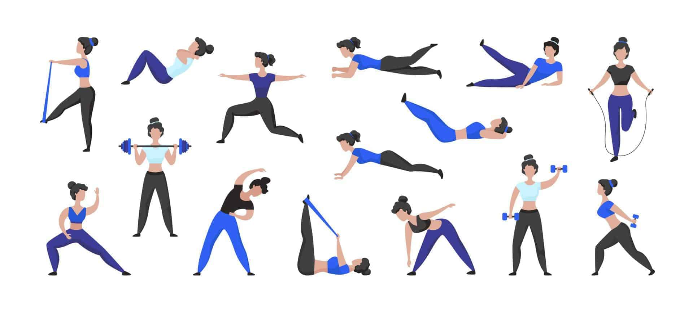
E - Content for Skill Enhancement Course For Semester - I (Under Graduate) DDU Gorakhpur University
SE1 PED
PHYSICAL FITNESS AND RECREATION
UNIT – II
LEARNING VARIOUS TYPES OF EXERCISES
Developed and Compiled by:
Prof. Vijay Chahal, Department of Physical Education, DDU Gorakhpur University, Gorakhpur.
Mr. Akash Vishwakarma, Guest Faculty, Department of Physical Education, DDU Gorakhpur University, Gorakhpur.

Slide 2
LEARNING DIFFERENT TYPES OF EXERCISES

Slide 3
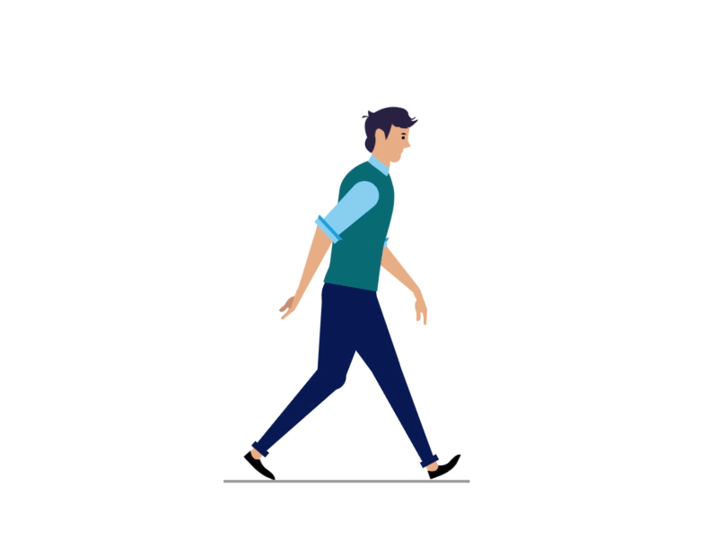
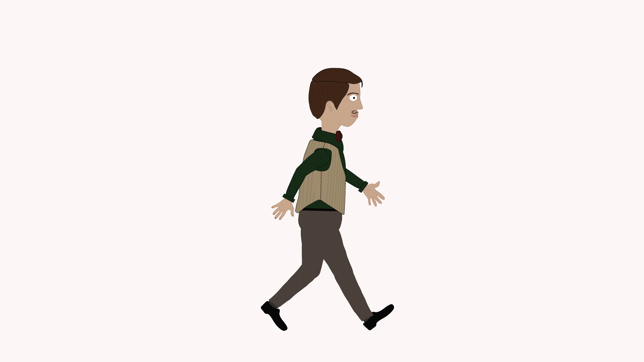
Cardiovascular Exercises
Improve heart health and endurance.
Walking: A low-impact exercise great for beginners.
1.Casual or Leisure Walking
A relaxed, slow-paced walk for leisure or basic movement.
Examples: Strolling in a park, window shopping.
2. Brisk Walking
A faster pace that elevates heart rate but doesn't cause exhaustion.
Often done for fitness or cardiovascular benefits.
3. Power Walking
Involves walking at a very fast pace, often incorporating exaggerated arm movements.
Focuses on aerobic fitness and calorie burning.
4. Speed Walking
Faster than power walking, typically a step below jogging.
Maintains one foot on the ground at all times to differentiate from running.
5. Race Walking
A competitive form of walking with specific rules (e.g., one foot must be in contact with the ground at all times).
Regulated as an Olympic sport.
6. Nordic Walking
Walking with specially designed poles to engage upper body muscles.
Offers a full-body workout.

Slide 4
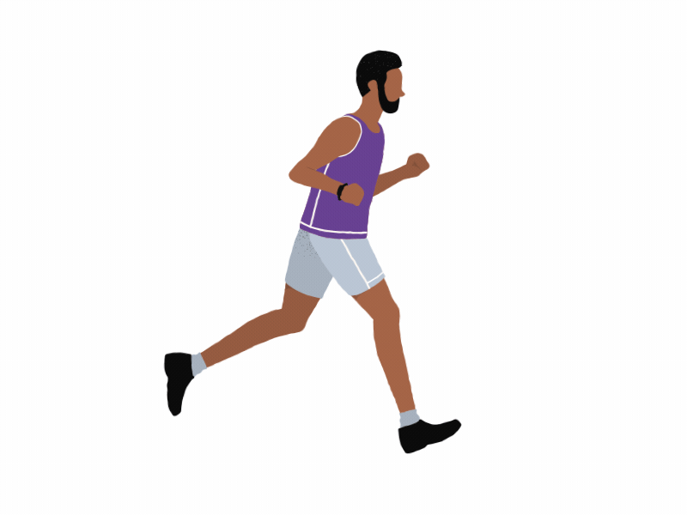
Jogging/Running
Builds stamina and cardiovascular strength.
Strengthens legs and improves heart health.
Procedure:
Start with a 5-minute brisk walk or light jog to warm up.
Run at a moderate pace, maintaining steady breathing.
Land softly on the midfoot and avoid heavy heel strikes.
Gradually increase speed or duration as endurance builds.
Cool down with a slow jog or walk for 5-10 minutes and stretch.
Do's:
Invest in good running shoes designed for your foot type.
Follow a gradual progression in speed and distance to avoid injury.
Run on softer surfaces like grass or trails to reduce joint impact.
Don'ts:
Don’t skip warm-ups; they help prevent cramps and injuries.
Avoid running with poor posture; it can lead to strain.

Slide 5
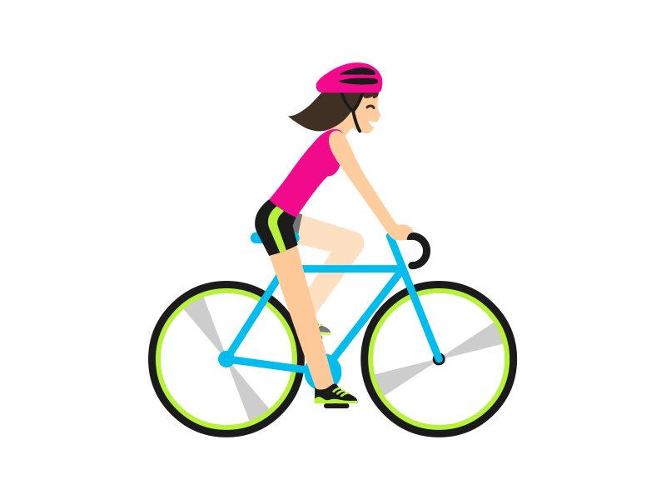
Cycling
Procedure:
Adjust the bike seat height to ensure your knees are slightly bent when the pedal is at its lowest point.
Start at a low resistance and pedal at a steady pace.
Maintain a comfortable posture with a firm grip on the handlebars.
Gradually increase speed or resistance for a more intense workout.
Finish with a cool-down at a lower intensity for 5 minutes.
Do's:
Wear a helmet for safety, especially when cycling outdoors.
Check your bike's brakes and tires before starting.
Use a water bottle holder to stay hydrated.
Don'ts:
Avoid slouching; maintain a straight back to prevent back pain.
Don’t overexert yourself on steep inclines without preparation.

Slide 6
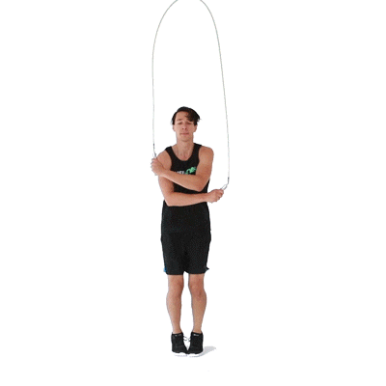
Jump Rope
Procedure:
Hold the rope handles firmly and stand with feet shoulder-width apart.
Swing the rope over your head and jump just high enough for the rope to pass under your feet.
Keep a steady rhythm and land softly on the balls of your feet.
Gradually increase the duration as coordination improves.
Do's:
Use a properly sized rope for your height.
Warm up and stretch before starting to prevent injury.
Focus on small, controlled jumps to reduce impact on joints.
Don'ts:
Don’t jump too high; it wastes energy and stresses the knees.
Avoid uneven surfaces; they can cause tripping or ankle injuries.

Slide 7
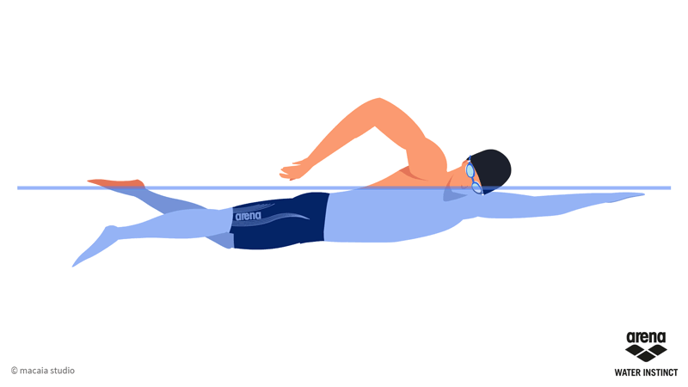
Swimming
Full-body workout that’s easy on the joints.
Procedure:
Begin with light stretches to loosen up your muscles.
Enter the water slowly and acclimate your body temperature.
Use basic strokes like freestyle, breaststroke, or backstroke, depending on your skill level.
Breathe regularly and maintain a steady pace.
Cool down with a few slow laps and stretches after exiting the water.
Do's:
Use proper swim gear, including goggles and swim caps if needed.
Practice in supervised areas, especially if you're a beginner.
Stay hydrated even while swimming.
Don'ts:
Don’t skip warm-ups; sudden exertion in cold water can be risky.
Avoid holding your breath for too long; it may cause dizziness.

Slide 8
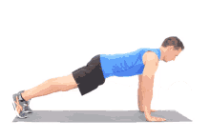
2. STRENGTH TRAINING EXERCISES
Build muscle and improve bone density.
Bodyweight Exercises (No equipment needed):
1. Push-Ups
Target Areas: Chest, shoulders, triceps, and core.
Procedure:
Begin in a plank position with your hands slightly wider than shoulder-width apart, fingers pointing forward.
Keep your body in a straight line from head to heels. Engage your core to avoid sagging hips or arching your back.
Lower your body by bending your elbows until your chest nearly touches the ground. Keep elbows at a 45-degree angle to your body.
Push back up to the starting position by straightening your arms. Tip: If you’re a beginner, modify by placing your knees on the ground or performing incline push-ups against a sturdy surface like a table or wall.

Slide 9
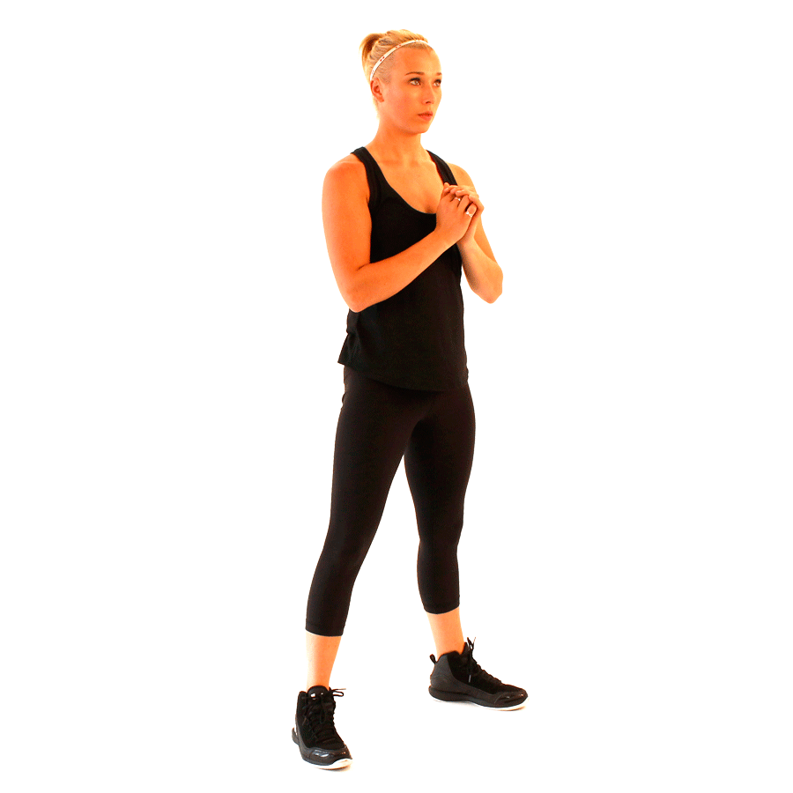
2. SQUATS
Target Areas: Legs, glutes, and core.
Procedure:
Stand with feet shoulder-width apart, toes pointing slightly outward.
Keep your chest lifted, back straight, and core engaged.
Push your hips back as if sitting in a chair while bending your knees. Ensure your knees stay aligned with your toes and do not extend past them.
Lower yourself until your thighs are parallel to the ground or as far as comfortable.
Push through your heels to return to the standing position.
Tip: Hold your arms straight out for balance or keep them at your chest.

Slide 10
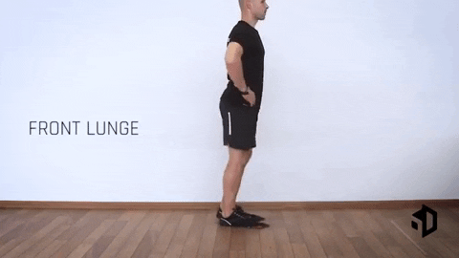
3. LUNGES
Target Areas: Legs, glutes, and balance.
Procedure:
Stand upright with feet hip-width apart and hands on your hips or at your sides.
Step one foot forward, lowering your body by bending both knees until they form 90-degree angles. The back knee should hover slightly above the ground.
Keep your torso upright and your front knee aligned with your toes.
Push through your front heel to return to the starting position.
Alternate legs or perform all reps on one leg before switching. Tip: Focus on control and balance; avoid rushing through the movement.

Slide 11
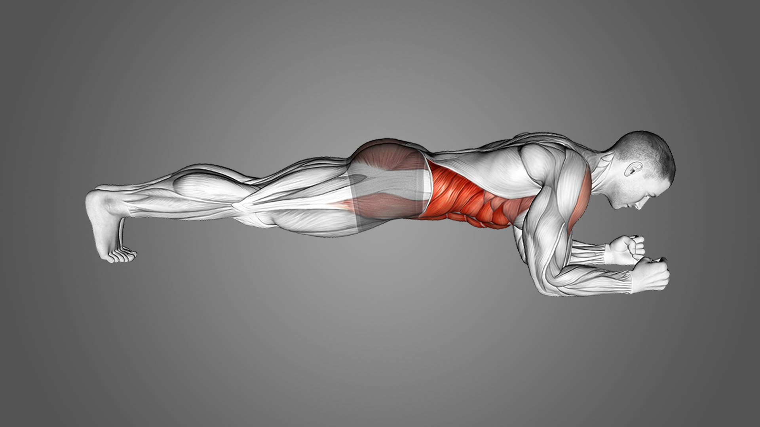
4. PLANK
Target Areas: Core, shoulders, and overall stability.
Procedure:
Lie face down on the ground. Lift your body onto your forearms and toes, with forearms directly under your shoulders.
Keep your body in a straight line from head to heels. Avoid sagging your hips or raising them too high.
Engage your core, glutes, and thighs to maintain the position.
Hold the plank for a set duration (e.g., 20–60 seconds), then rest.
Tip: For beginners, perform a plank on your knees or against an elevated surface.

Slide 12
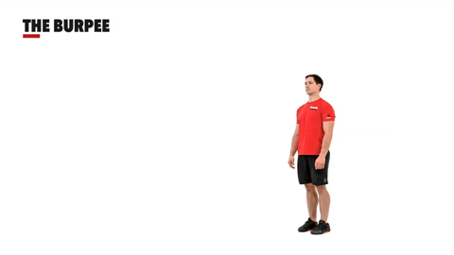
5. BURPEES
Target Areas: Full body (strength and cardio).
Procedure:
Start standing, then squat down and place your hands on the ground.
Jump your feet back into a plank position.
Perform a push-up, then jump your feet forward.
Explode into a jump from the squat position.
Tip: Modify by skipping the push-up or jump if needed.

Slide 13
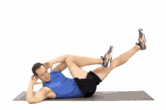
6. BICYCLE CRUNCHES
Target Areas: Abs and obliques.
Procedure:
Lie on your back with hands behind your head.
Lift your shoulders off the ground and bring one elbow toward the opposite knee while extending the other leg.
Alternate sides in a pedaling motion.
Tip: Avoid pulling on your neck.

Slide 14
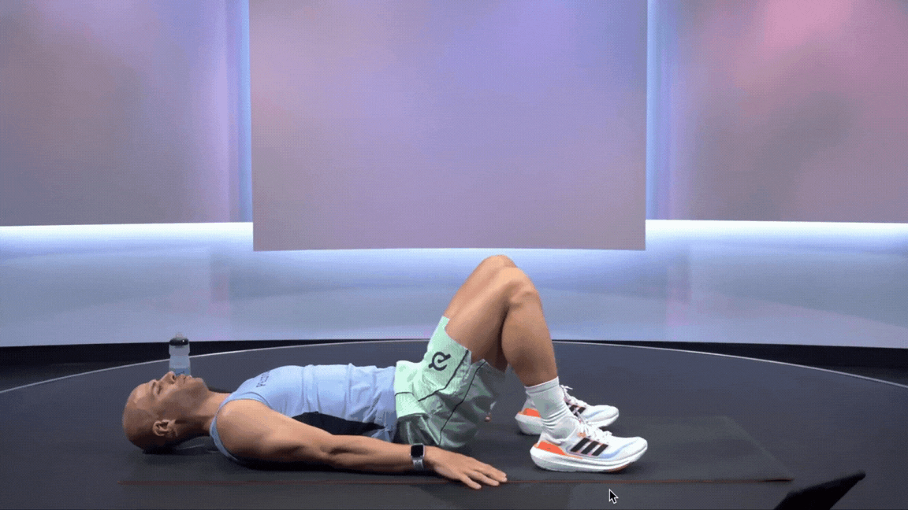
GLUTE BRIDGES
Target Areas: Glutes, hamstrings, and lower back.
Procedure:
Lie on your back with knees bent and feet flat on the ground.
Lift your hips toward the ceiling, squeezing your glutes.
Lower back down.
Tip: Keep your core tight throughout the movement.

Slide 15
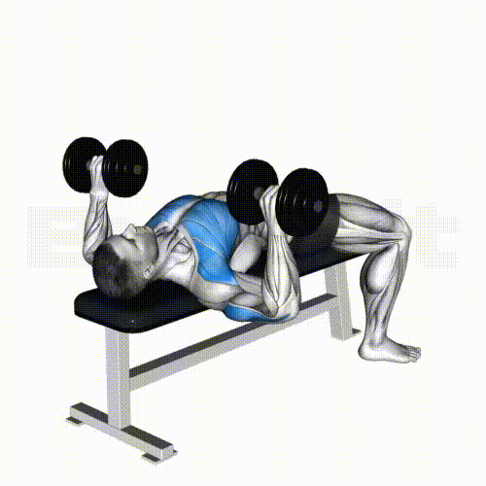
1. DUMBBELL BENCH PRESS
Target Areas: Chest, shoulders, triceps.
Procedure:
Lie flat on a bench holding a dumbbell in each hand at chest level, palms facing forward.
Press the dumbbells upward until your arms are fully extended.
Lower the dumbbells back to the starting position.
Tip: Keep your feet flat on the ground and maintain control throughout the movement.

Slide 16
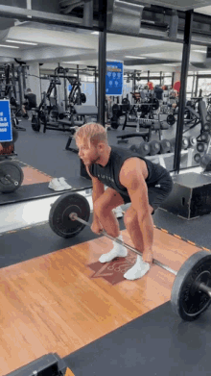
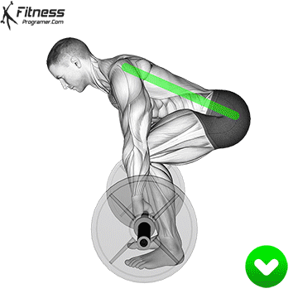
2. DEADLIFT
Target Areas: Back, glutes, hamstrings, core.
Procedure:
Stand with feet hip-width apart, barbell or dumbbells in front of you.
Hinge at the hips and grip the bar/dumbbells.
Lift the weight by straightening your hips and knees, keeping your back straight.
Lower the weight back to the starting position.
Tip: Keep the weight close to your body and avoid rounding your back.

Slide 17
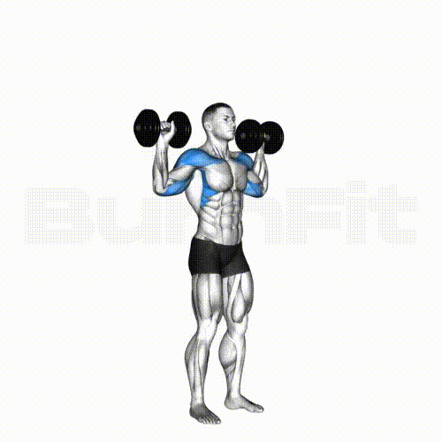
3. Dumbbell Shoulder Press
Target Areas: Shoulders, triceps.
Procedure:
Hold a dumbbell in each hand at shoulder height, palms facing forward.
Press the dumbbells upward until your arms are fully extended.
Lower the dumbbells back to the starting position.
Tip: Engage your core to prevent arching your lower back.

Slide 18
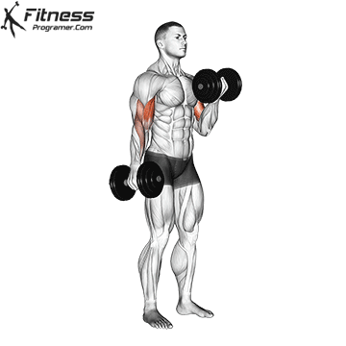
4. DUMBBELL BICEP CURL
Target Areas: Biceps.
Procedure:
Stand upright, holding a dumbbell in each hand with palms facing forward.
Curl the weights upward while keeping your elbows close to your body.
Lower the dumbbells back down.
Tip: Avoid swinging the weights or using momentum.

Slide 19
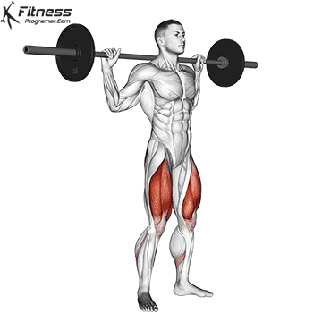
5. BARBELL SQUAT
Target Areas: Quads, glutes, hamstrings, core.
Procedure:
Place a barbell on your upper back and stand with feet shoulder-width apart.
Squat down by bending your knees and hips, keeping your chest up and back straight.
Push through your heels to return to standing.
Tip: Avoid letting your knees cave inward.

Slide 20
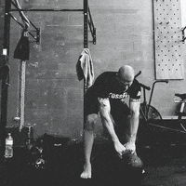
6. KETTLEBELL SWING
Target Areas: Glutes, hamstrings, core, shoulders.
Procedure:
Stand with feet shoulder-width apart, holding a kettlebell with both hands.
Hinge at the hips to swing the kettlebell between your legs.
Thrust your hips forward to swing the kettlebell to chest height.
Tip: Use your hips, not your arms, to drive the movement.

Slide 21
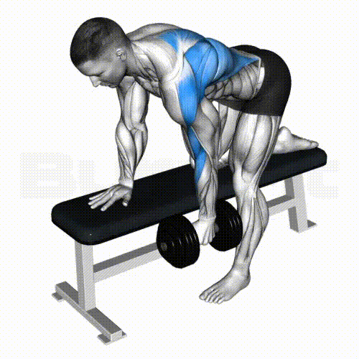
7. DUMBBELL ROW
Target Areas: Back, biceps.
Procedure:
Place one knee and hand on a bench for support, holding a dumbbell in the other hand.
Pull the dumbbell toward your torso, squeezing your shoulder blade.
Lower the dumbbell back down.
Tip: Keep your back flat and core engaged.

Slide 22
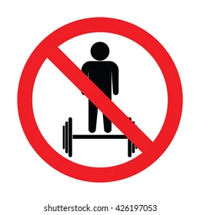
SAFETY TIPS FOR WEIGHT-BASED EXERCISES
Warm up before starting with dynamic stretches or light cardio.
Use proper form to prevent injuries.
Start with lighter weights and gradually increase as you gain strength.
Breathe properly: inhale during the lowering phase, exhale during the lifting phase.

Slide 23
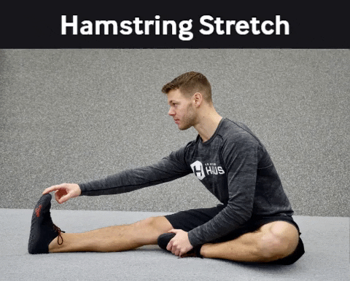
3. FLEXIBILITY AND MOBILITY EXERCISES
Improve range of motion and prevent injury.
1. Stretching Exercises
Goal: Improve flexibility by elongating muscles.
a. Hamstring Stretch
Sit on the floor with one leg extended and the other foot tucked into your inner thigh.
Reach toward the toes of the extended leg, keeping your back straight.
Hold for 20–30 seconds, then switch legs.
Tip: Avoid rounding your back; focus on a gentle stretch.

Slide 24
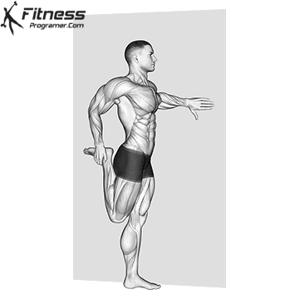
B. QUADRICEPS STRETCH
Stand upright and hold onto a wall or chair for balance if needed.
Bend one knee, bringing your foot toward your glutes.
Grab your ankle with the same-side hand and gently pull the foot closer.
Hold for 20–30 seconds, then switch sides.
Tip: Keep your knees close together and avoid arching your back.

Slide 25
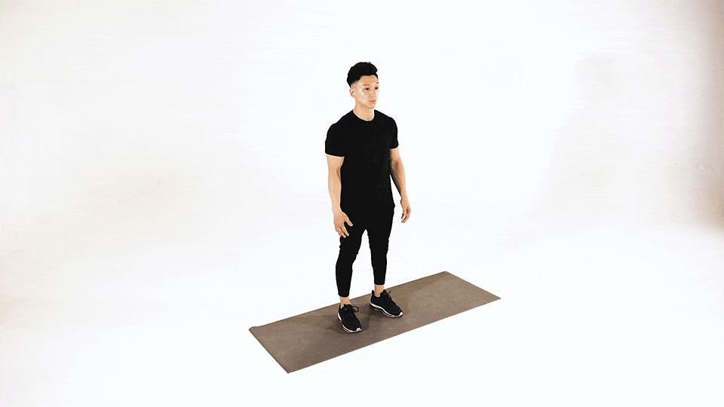
C. SHOULDER STRETCH
Extend one arm across your chest.
Use the opposite hand to gently press your extended arm toward your chest.
Hold for 20–30 seconds, then switch arms.
Tip: Relax your shoulders during the stretch.

Slide 26
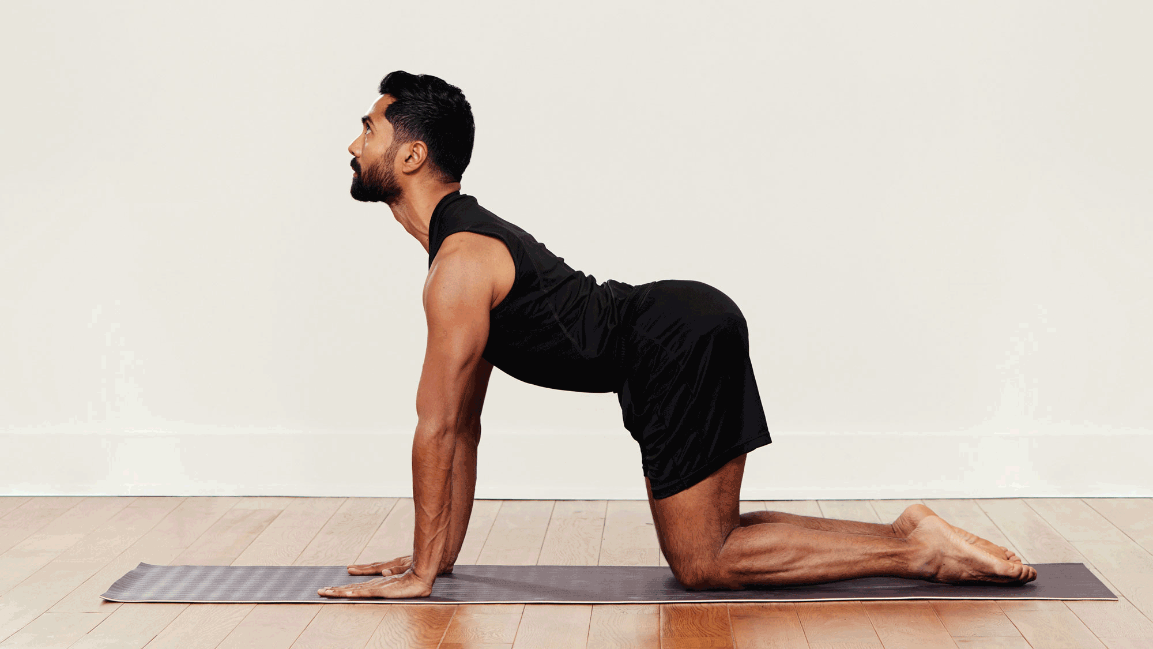
D. BACK STRETCH (CAT-COW STRETCH)
Begin on all fours with hands under shoulders and knees under hips.
Arch your back upward (Cat Pose), tucking your chin toward your chest.
Reverse the motion by dipping your back and lifting your head and tailbone (Cow Pose).
Alternate between poses for 10–12 reps.
Tip: Move slowly and breathe deeply.

Slide 27
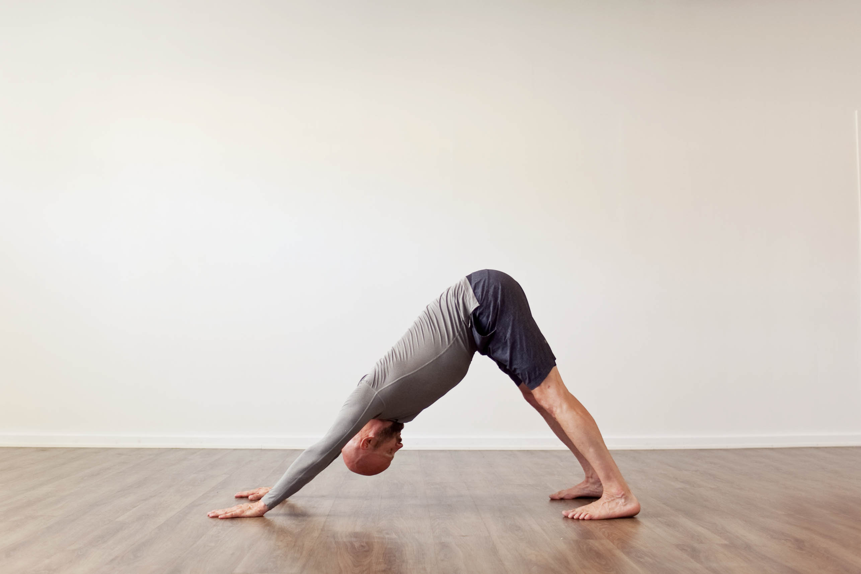
2. Yoga Poses
Goal: Combine flexibility, strength, and mindfulness.
1. Downward Dog Pose (Adho Mukha Svanasana)
Benefits
Stretches the hamstrings, calves, and shoulders.
Strengthens the arms and legs.
Improves posture and full-body flexibility.
Procedure
Start on all fours with hands under shoulders and knees under hips.
Spread your fingers wide and press firmly into your palms.
Tuck your toes under and lift your hips toward the ceiling, forming an inverted “V” shape.
Straighten your legs (if possible) and let your heels sink toward the floor.
Relax your head and neck, keeping your gaze toward your thighs.
Hold for 5-10 breaths, then release by lowering your knees.

Slide 28
2. Cat-Cow Stretch (Marjaryasana-Bitilasana)
Benefits
Increases flexibility in the spine.
Improves posture and balance.
Gently massages the abdominal organs.
Procedure
Begin in a tabletop position with your wrists under your shoulders and knees under your hips.
For Cow Pose, inhale and arch your back, lifting your tailbone and chest while your belly sinks. Look up gently.
For Cat Pose, exhale and round your spine, tucking your chin to your chest and pulling your belly button toward your spine.
Alternate between the two poses for 8-10 rounds of breath.

Slide 29
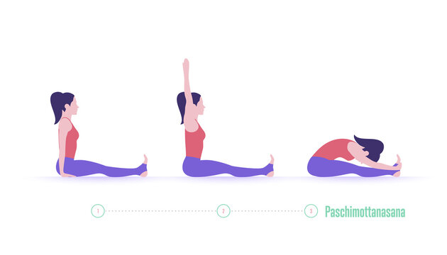
3. Seated Forward Bend (Paschimottanasana)
Benefits
Stretches the spine, hamstrings, and calves.
Relieves stress and calms the mind.
Enhances flexibility in the lower back and hips.
Procedure
Sit on the floor with your legs extended straight in front of you.
Inhale, raise your arms overhead, and elongate your spine.
Exhale and fold forward from the hips, reaching for your feet or shins.
Keep your spine long and avoid rounding your back.
Hold the position for 20-30 seconds, breathing deeply, then release.

Slide 30
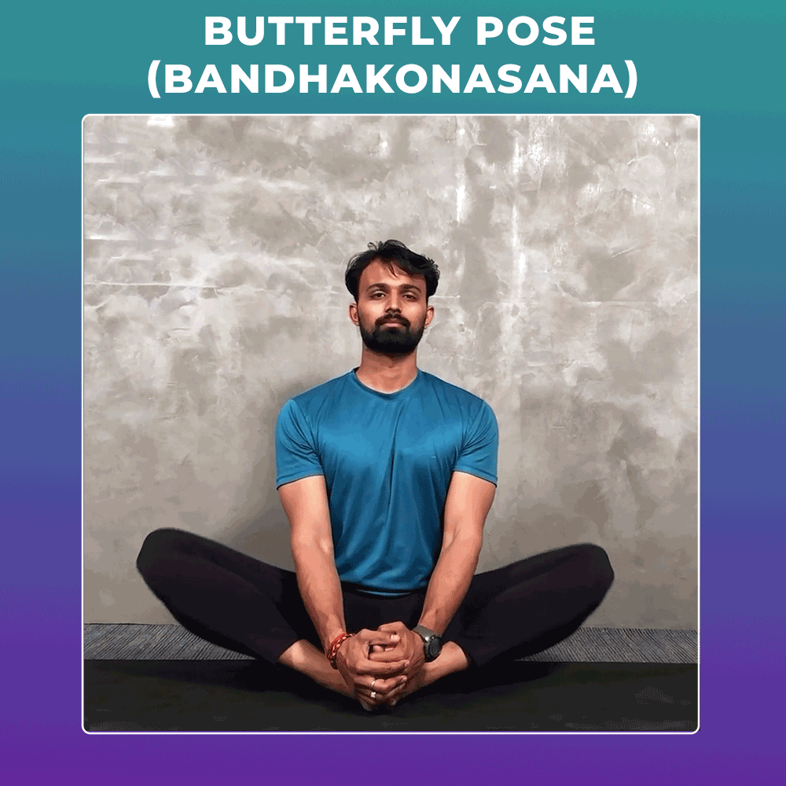
4. Butterfly Pose (Baddha Konasana)
Benefits
Opens the hips and inner thighs.
Increases flexibility in the groin and knees.
Stimulates circulation in the lower body.
Procedure
Sit with your legs extended straight.
Bend your knees and bring the soles of your feet together, letting your knees drop to the sides.
Hold your feet with your hands and pull them gently toward your pelvis.
Sit tall, elongating your spine, and press your knees closer to the floor (without forcing).
Hold for 30-60 seconds, then slowly release.

Slide 31
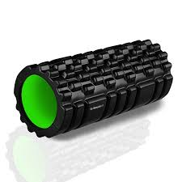
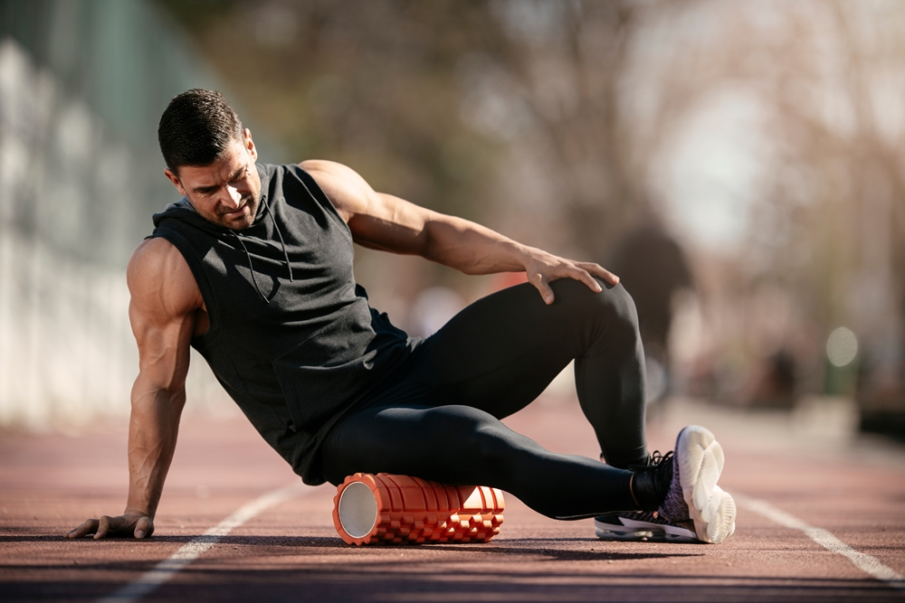
3. Foam Rolling
Goal: Relieve muscle tightness and improve mobility.
1. Hamstrings (Back of the Thighs)
Position: Sit on the floor with your legs extended and the foam roller placed under your thighs.
Procedure:
Place your hands on the floor behind you for support.
Lift your hips slightly off the ground and shift your weight onto the foam roller.
Roll slowly back and forth from just above the knees to the base of the glutes.
Spend extra time on tight or tender spots, pausing to allow the muscle to relax.
Tip: To increase intensity, cross one leg over the other to focus on one hamstring at a time.

Slide 32
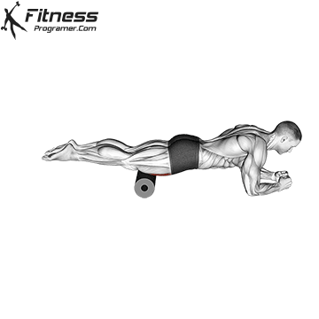
2. QUADS (FRONT OF THE THIGHS)
Position: Lie face down with the foam roller under your thighs.
Procedure:
Support your upper body on your forearms or hands, keeping your core engaged.
Roll slowly from the top of your hips to just above your knees.
Stop at any tight areas and hold pressure for 20–30 seconds.
Tip: For deeper relief, shift your weight slightly to target the outer or inner thighs.

Slide 33
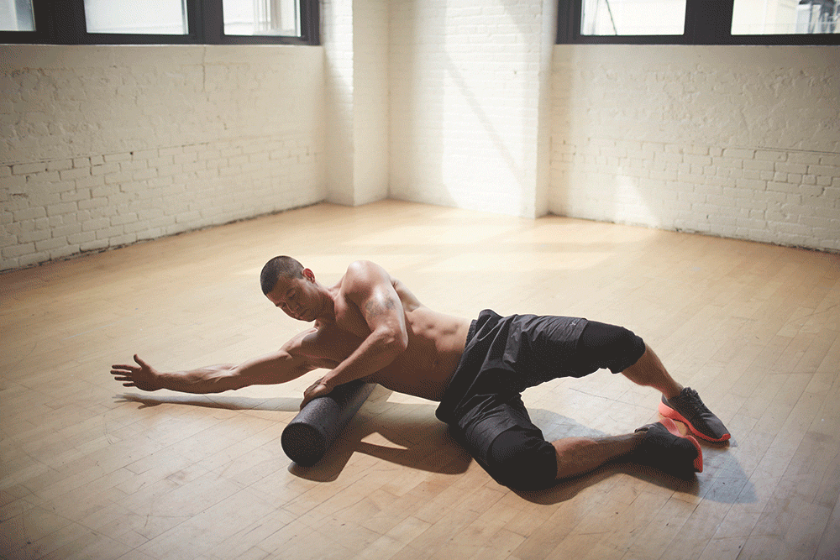
3. SHOULDERS (UPPER BACK AND TRAPS)
Position: Lie on your back with the foam roller placed horizontally under your upper back, near the shoulder blades.
Procedure:
Bend your knees, placing your feet flat on the floor.
Support your head with your hands or cross your arms over your chest.
Roll from the middle of your back to the base of your neck, pausing on tight spots.
Tip: Keep your movements slow and controlled. Avoid rolling directly on your neck.

Slide 34
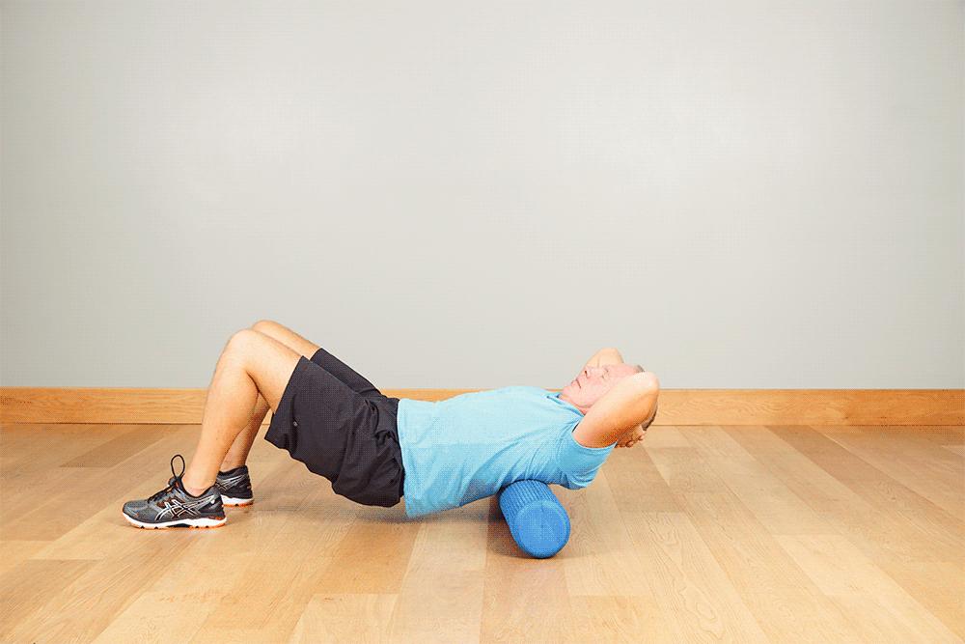
4. BACK (LOWER AND MID-BACK)
Position: Sit on the foam roller, then lean back so the roller is under your lower back.
Procedure:
Place your hands on the floor behind you for support.
Roll from your lower back (just above the hips) to your mid-back.
Focus on maintaining proper posture—avoid arching your back excessively.
Tip: Avoid rolling directly over your spine; shift slightly to either side for better muscle

Slide 35
GENERAL FOAM ROLLING TIPS
Move Slowly: Roll at a pace of about 1 inch per second to allow your muscles to respond to the pressure.
Pause on Tight Spots: Hold for 20–30 seconds on areas that feel particularly tight to encourage muscle relaxation.
Breathe Deeply: Relax your muscles by exhaling deeply as you roll or pause.
Avoid Joints: Do not roll directly over joints, such as the knees, or bony areas.
Duration: Spend about 1–2 minutes on each muscle group.

Slide 36
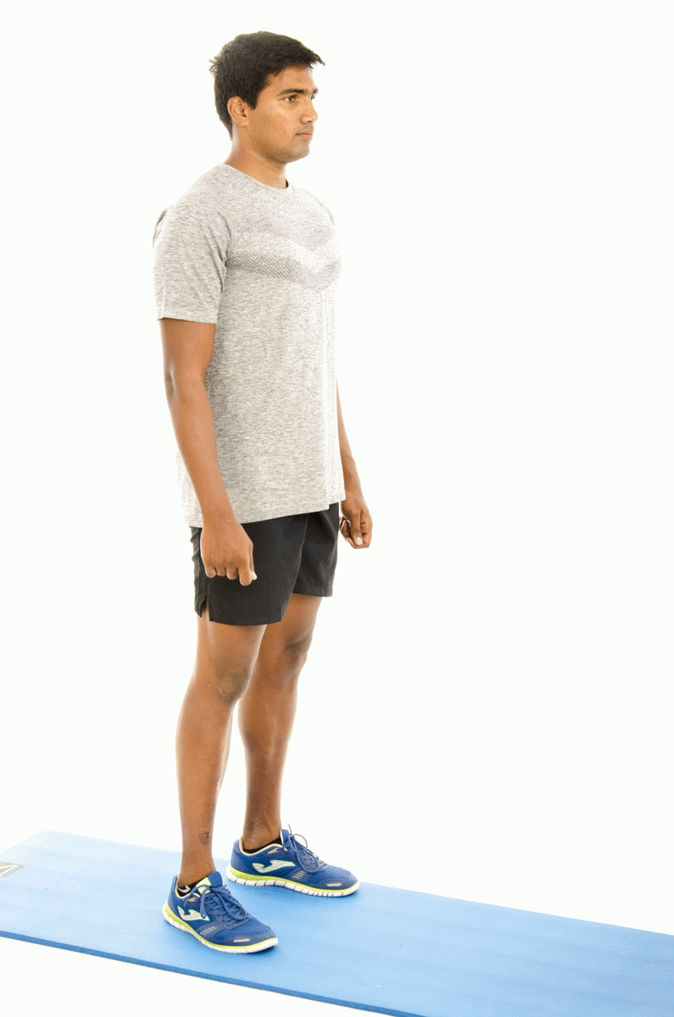
4. BALANCE AND STABILITY EXERCISES
Enhance control and coordination.
1. Standing on One Leg
Procedure
Stand tall with your feet hip-width apart.
Slowly shift your weight to your right leg.
Lift your left foot off the ground, bending the knee to form a 90-degree angle.
Hold for 20-30 seconds (or longer as you progress).
Repeat on the opposite leg.
For added challenge, close your eyes or hold the position on a soft surface like a yoga mat.
Benefits
Strengthens the ankle and leg muscles.
Improves body awareness and balance control.
Enhances stability for daily activities and sports.

Slide 37
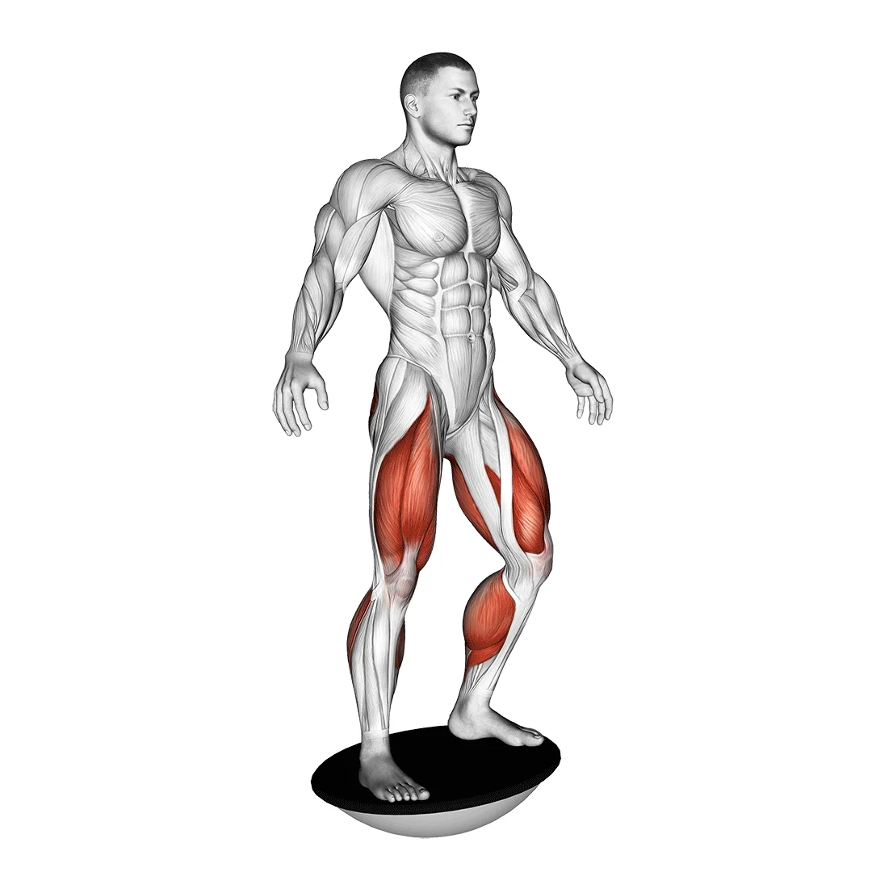
2. Balance Board (Wobble Board Exercise)
Procedure
Place the balance board on a flat surface.
Stand on the board with both feet shoulder-width apart, knees slightly bent.
Try to keep the board level without letting the edges touch the ground.
Shift your weight from side to side or front to back to maintain balance.
Start with 30 seconds and gradually increase the duration.
Benefits
Strengthens the core, ankles, and leg muscles.
Improves coordination and proprioception (sense of body position).
Reduces the risk of ankle injuries.

Slide 38
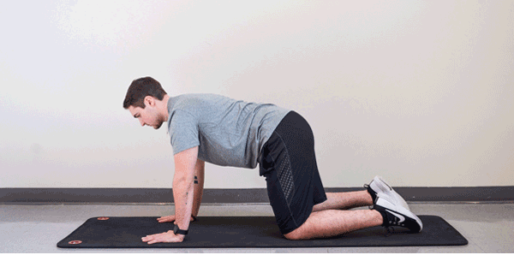
3. BIRD DOG
Procedure
Start in a tabletop position, with your hands under your shoulders and knees under your hips.
Extend your right arm forward and left leg backward simultaneously, keeping your torso stable.
Hold for 2-3 seconds, ensuring your back stays straight.
Slowly return to the starting position.
Repeat on the other side, alternating for 8-10 repetitions on each side.
Benefits
Strengthens the core, lower back, and glutes.
Improves balance and coordination.
Promotes spinal stability and reduces the risk of back pain.

Slide 39
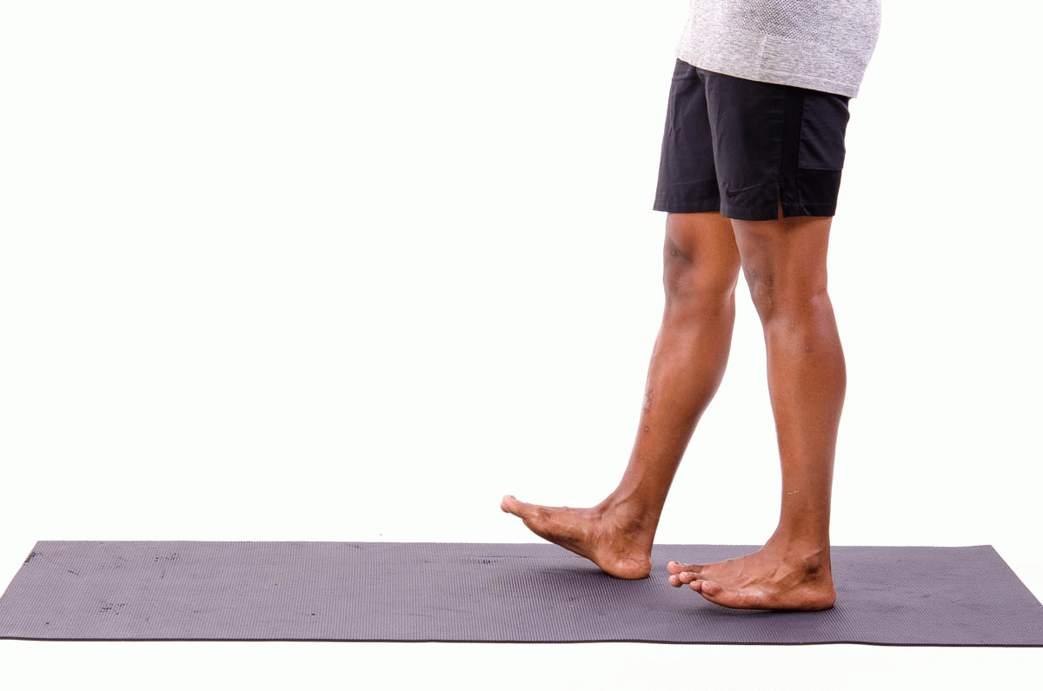
4. HEEL-TO-TOE WALK
Procedure
Stand tall and place your right foot directly in front of your left foot, with the heel of the right foot touching the toes of the left.
Slowly lift your left foot and step it forward, placing the heel directly in front of the right toes.
Continue walking in a straight line, focusing on control and balance.
Perform 10-12 steps, then repeat in the opposite direction.
Benefits
Improves balance and gait stability.
Strengthens small stabilizing muscles in the feet and ankles.
Enhances focus and concentration.

Slide 40
REFERENCES
https://dribbble.com/shots/4324522-Racetrack-Runner
https://in.pinterest.com/pin/crisscross--290060032255405290/
https://trainerpl.us/exercise-of-the-month/squats
https://giphy.com/explore/front-lunge
https://tenor.com/en-IN/search/cycling-crunch-gifs
https://www.onepeloton.com/blog/glute-bridge/
https://www.jefit.com/exercises/882/shoulder-stretch
https://www.yogajournal.com/poses/anatomy/spine/yoga-poses-for-your-spine/
https://www.thewellnesscorner.com/blog/bedtime-stretches-and-breathing-for-sound-sleep
https://fitnessvolt.com/balance-board-guide/

